Slide 1
Agile vs Waterfall Lessons from the SNHU Travel Project
Justin Ertl CS-250 8/17/2025

Slide 2
Agenda
01 | Scrum - Agile Roles
02 | Agile Phases of SDLC
03 | Waterfall Model
04 | Choosing Agile or Waterfall
05 | References

Slide 3
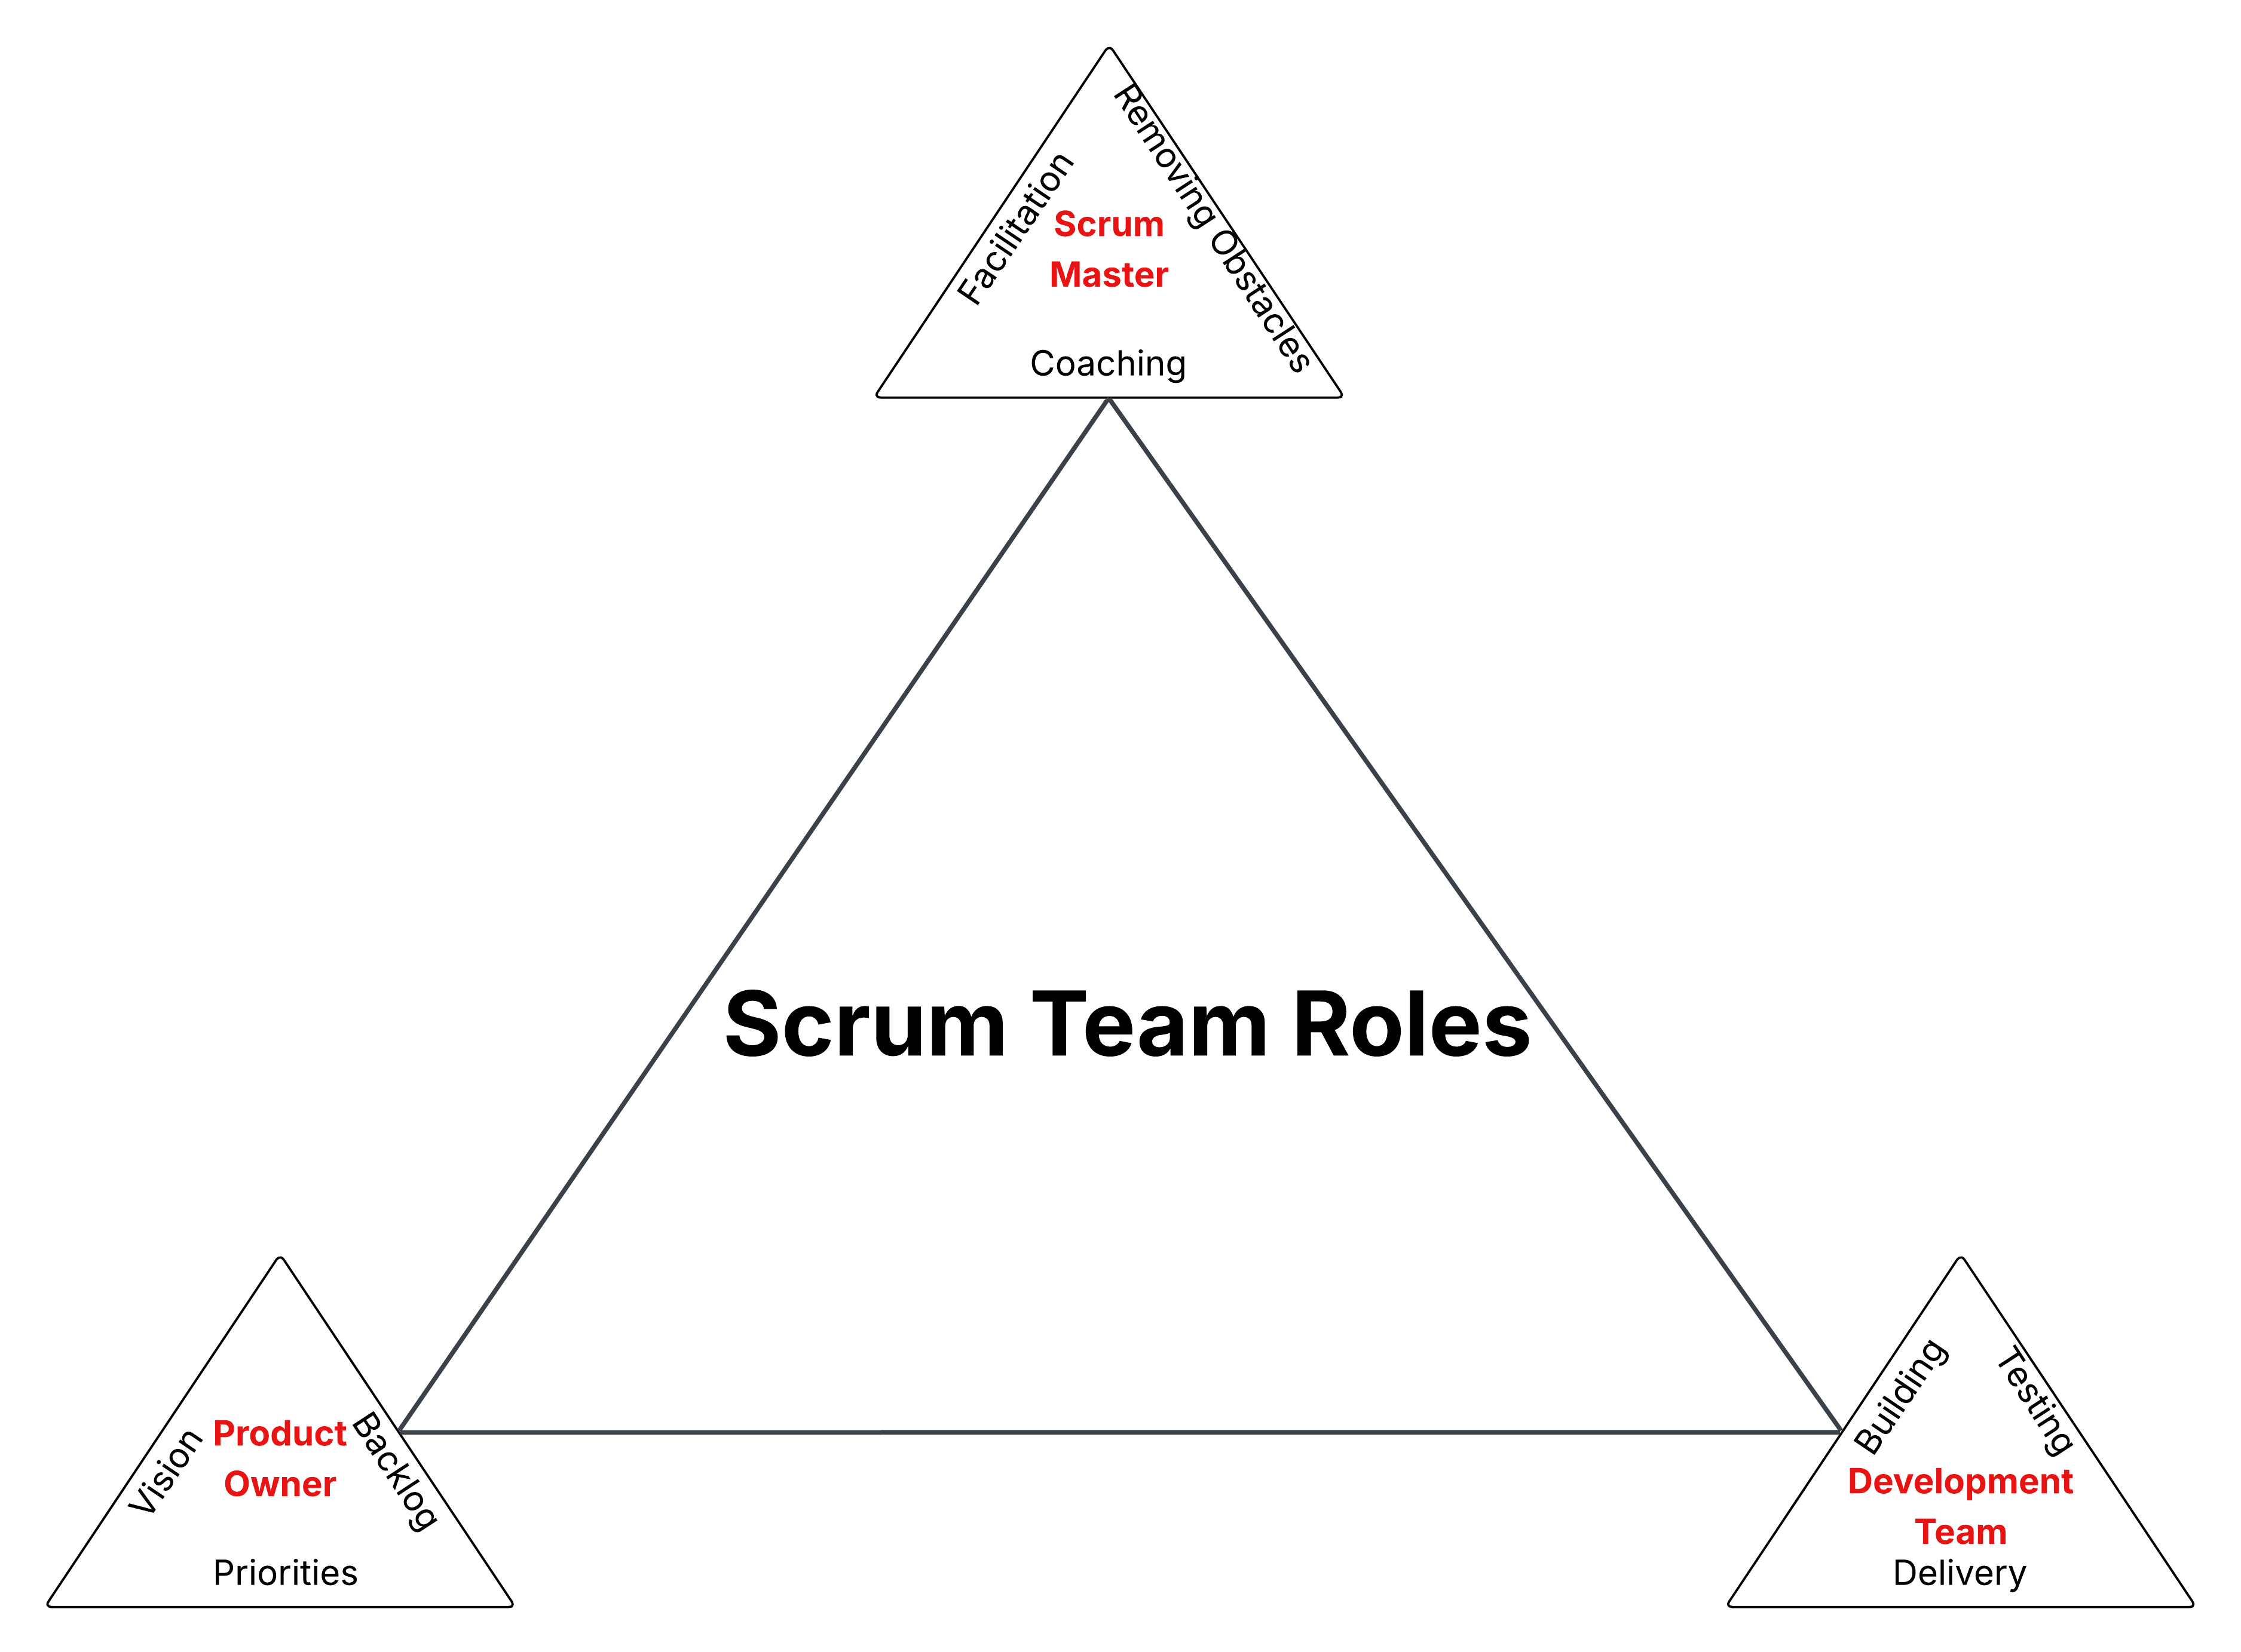
Scrum – Agile Roles
Product Owner
Defines product vision and goals
Manages product backlog
Prioritizes features based on value
Scrum Master
Facilitates Scrum process and events
Removes obstacles for the team
Ensures adherence to Agile principles
Development Team
Cross-functional (design, code, testing)
Includes some testers as team members
Self-organizing, no formal sub-roles
Delivers working product functionality each sprint

Slide 4
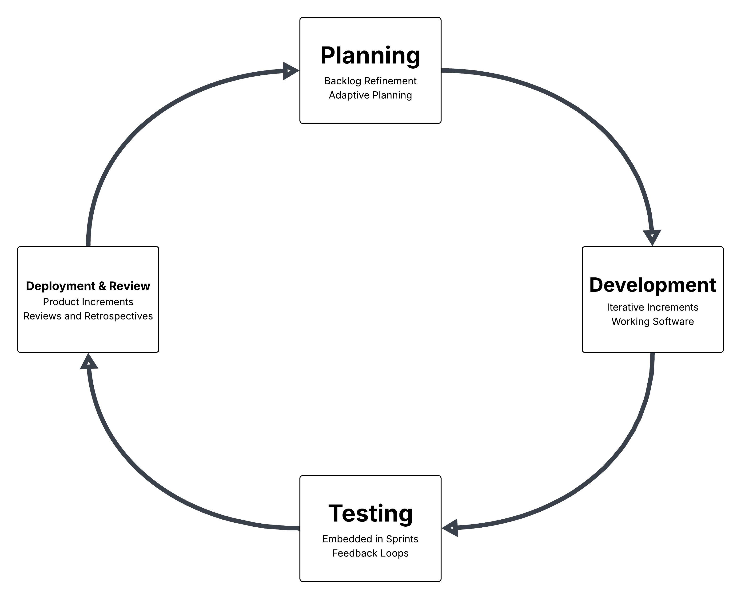
Agile Phases of SDLC
Planning
Backlog refinement and adaptive release planning
Focus on delivering highest-value features first
Development
Iterative increments of functionality
Emphasis on working software early and often
Testing
Continuous and embedded within sprints
Fast feedback loops for quality assurance
Deployment
Working product increments each sprint
Sprint reviews and retrospectives for improvement

Slide 5
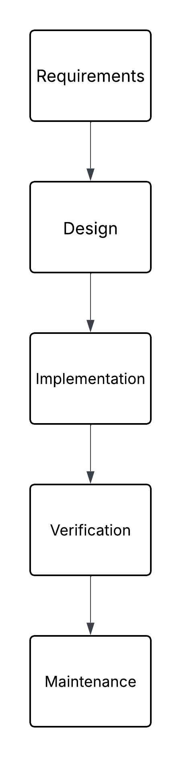
Waterfall Model
Linear, Phase-Gated Process
Challenges
Rigid structure, difficult to adapt to late changes
High risk of costly rework if requirements shift
Example – Wellness Vacation Feature
In Waterfall: Would require major redesign and delays
In Agile: Simply reprioritize backlog and developed in next sprint

Slide 6

Choosing Agile or Waterfall
Waterfall Best For
Fixed, stable requirements
Regulatory or compliance-heavy projects
Sequential, predictable work
Agile Best For
Evolving or unclear requirements
Fast feedback and user-driven change
Complex or innovative projects
Key Takeaway
SNHU Travel project: Agile improved adaptability, collaboration, and incremental delivery

Slide 7
References
Cobb, C. G. (2015). The Project Manager’s Guide to Mastering Agile.
Schwaber, K., & Sutherland, J. (2020). The Scrum Guide. Scrum.org.
Royce, W. W. (1970). Managing the development of large software systems. Proceedings of IEEE WESCON
Project Management Institute. (2021). A guide to the project management body of knowledge (PMBOK guide) (7th ed.).
Slide 6 Image Generated from ChatGPT

